Slide 1
Sampling and Types of Sampling Techniques, Types of Probability Sampling

Slide 2
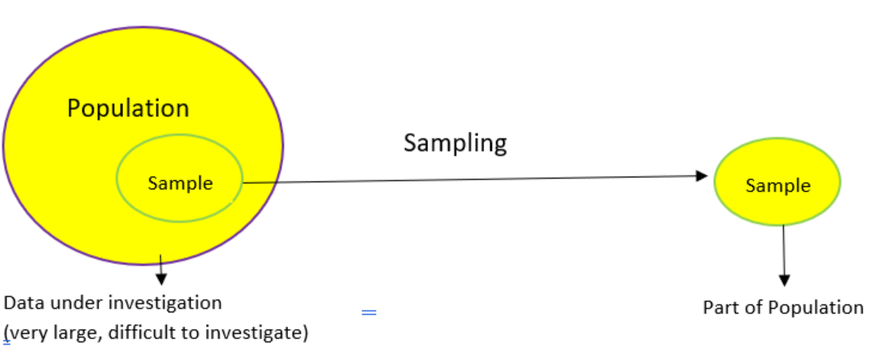
Sampling and types of sampling techniques
Sampling
Sampling is a method that allows us to get information about the population based on the statistics from a subset of the population (sample), without having to investigate every individual.

Slide 3

We want to find the average height of all adult males in Delhi.
The population of Delhi is around 3 crore and males would be roughly around 1.5 crores (these are general assumptions for this example so don’t take them at face value!).
As you can imagine, it is nearly impossible to find the average height of all males in Delhi.
It’s also not possible to reach every male so we can’t really analyze the entire population. So what can we do instead? We can take multiple samples and calculate the average height of individuals in the selected samples

Slide 4
But then we arrive at another question – how can we take a sample? Should we take a random sample? Or do we have to ask the experts?
Let’s say we go to a basketball court and take the average height of all the professional basketball players as our sample. This will not be considered a good sample because generally, a basketball player is taller than an average male and it will give us a bad estimate of the average male’s height.
Here’s a potential solution – find random people in random situations where our sample would not be skewed based on heights.
Why do we need Sampling?
Sampling is done to draw conclusions about populations from samples, and it enables us to determine a population’s characteristics by directly observing only a portion (or sample) of the population.
Selecting a sample requires less time than selecting every item in a population
Sample selection is a cost-efficient method
Analysis of the sample is less cumbersome and more practical than an analysis of the entire population

Slide 5
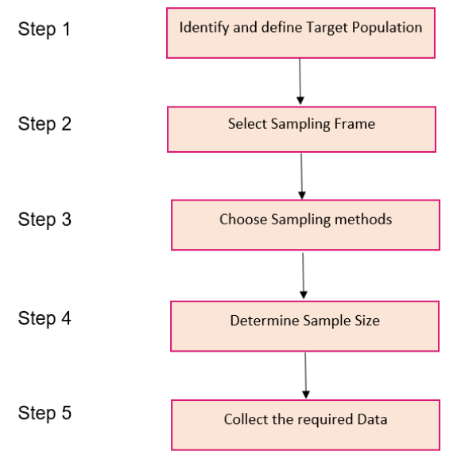
Steps involved in Sampling

Slide 6

Let’s take an interesting case study and apply these steps to perform sampling. We recently conducted General Elections in India . You must have seen the public opinion polls every news channel was running at the time:

Slide 7
Step 1
The first stage in the sampling process is to clearly define the target population.
So, to carry out opinion polls, polling agencies consider only the people who are above 18 years of age and are eligible to vote in the population.
Step 2
Sampling Frame – It is a list of items or people forming a population from which the sample is taken.
So, the sampling frame would be the list of all the people whose names appear on the voter list of a constituency.
Step 3
Generally, probability sampling methods are used because every vote has equal value and any person can be included in the sample irrespective of his caste, community, or religion. Different samples are taken from different regions all over the country.

Slide 8
Step 4
Sample Size – It is the number of individuals or items to be taken in a sample that would be enough to make inferences about the population with the desired level of accuracy and precision.
Larger the sample size, more accurate our inference about the population would be.
For the polls, agencies try to get as many people as possible of diverse backgrounds to be included in the sample as it would help in predicting the number of seats a political party can win.
Step 5
Once the target population, sampling frame, sampling technique, and sample size have been established, the next step is to collect data from the sample.
In opinion polls, agencies generally put questions to the people, like which political party are they going to vote for or has the previous party done any work, etc.
Based on the answers, agencies try to interpret who the people of a constituency are going to vote for and approximately how many seats is a political party going to win. Pretty exciting work, right?!

Slide 9
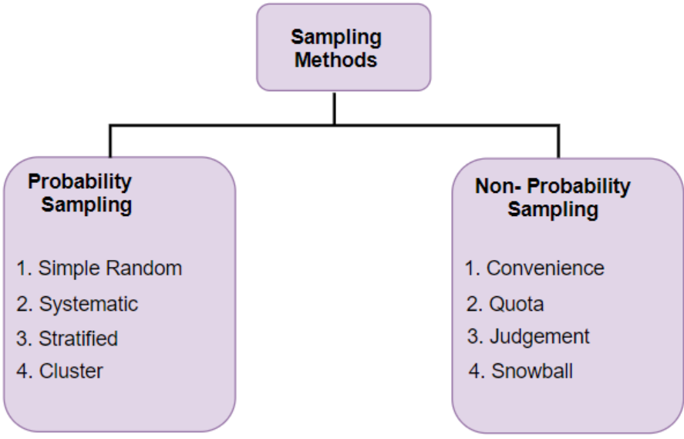
Different Types of Sampling Techniques

Slide 10
Probability Sampling:
In probability sampling, every element of the population has an equal chance of being selected. Probability sampling gives us the best chance to create a sample that is truly representative of the population
Non-Probability Sampling:
In non-probability sampling, all elements do not have an equal chance of being selected. Consequently, there is a significant risk of ending up with a non-representative sample which does not produce generalizable results
For example, let’s say our population consists of 20 individuals. Each individual is numbered from 1 to 20 and is represented by a specific color (red, blue, green, or yellow). Each person would have odds of 1 out of 20 of being chosen in probability sampling.
With non-probability sampling, these odds are not equal. A person might have a better chance of being chosen than others.

Slide 11
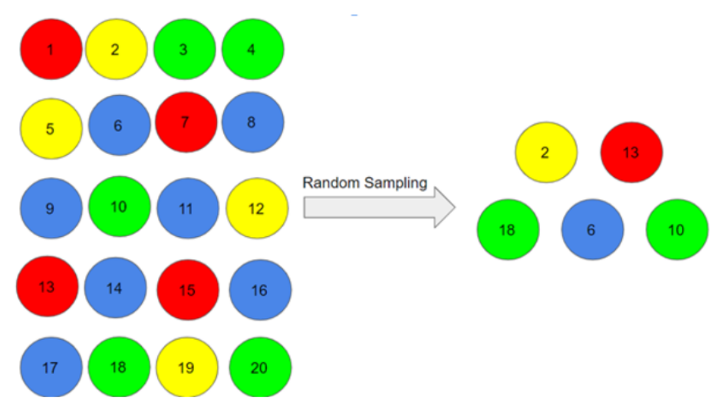
Types of Probability Sampling
Simple Random Sampling
This is a type of sampling technique you must have come across at some point. Here, every individual is chosen entirely by chance and each member of the population has an equal chance of being selected.

Slide 12
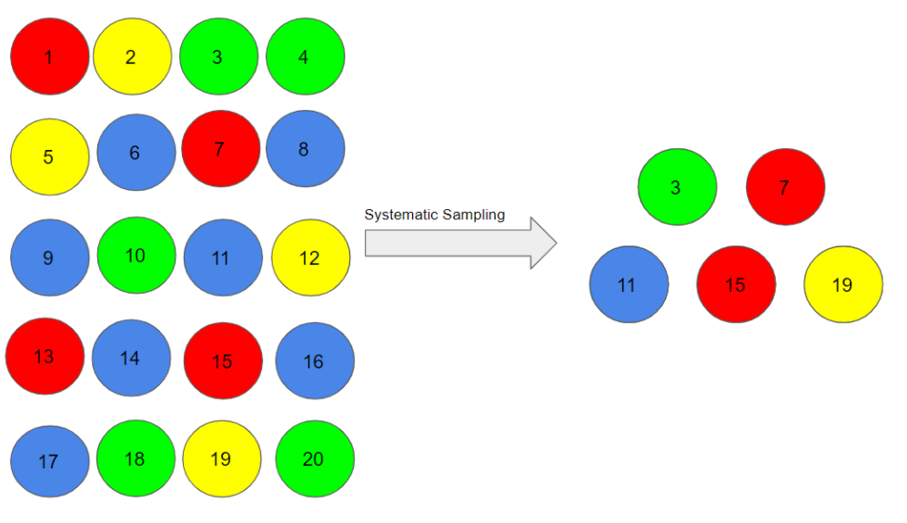
Systematic Sampling
In this type of sampling, the first individual is selected randomly and others are selected using a fixed ‘sampling interval’.
Say our population size is x and we have to select a sample size of n. Then, the next individual that we will select would be x/nth intervals away from the first individual. We can select the rest in the same way.

Slide 13
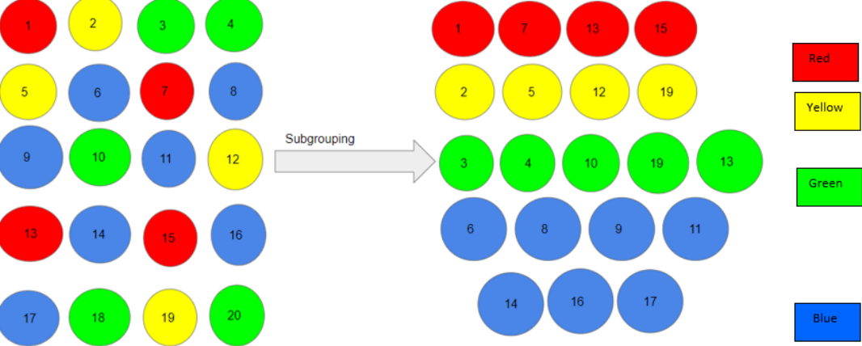
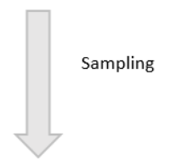
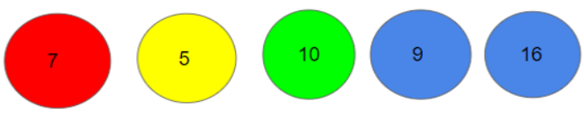
Suppose, we began with person number 3, and we want a sample size of 5. So, the next individual that we will select would be at an interval of (20/5) = 4 from the 3rd person, i.e. 7 (3+4), and so on.
3, 3+4=7, 7+4=11, 11+4=15, 15+4=19 = 3, 7, 11, 15, 19
Stratified Sampling
In this type of sampling, we divide the population into subgroups (called strata) based on different traits like gender, category, etc. And then we select the sample(s) from these subgroups:

Slide 14
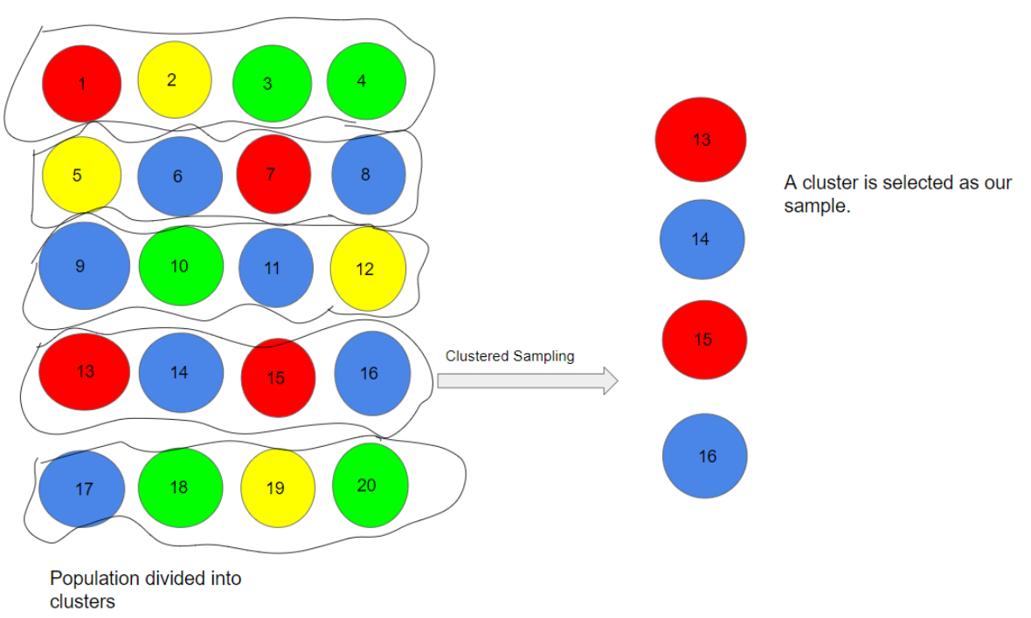
Cluster Sampling
In a clustered sample, we use the subgroups of the population as the sampling unit rather than individuals. The population is divided into subgroups, known as clusters, and a whole cluster is randomly selected to be included in the study.

Slide 15
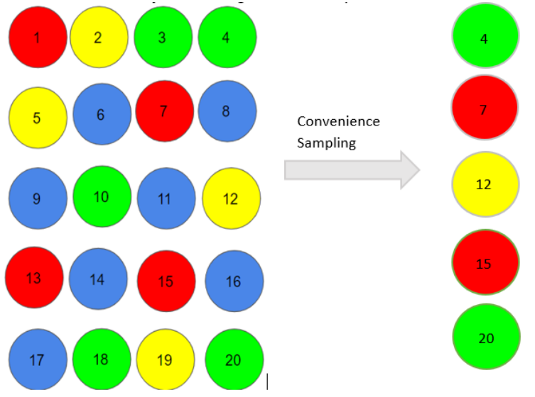
Types of Non-Probability Sampling
Convenience Sampling
This is perhaps the easiest method of sampling because individuals are selected based on their availability and willingness to take part.
Here, let’s say individuals numbered 4, 7, 12, 15 and 20 want to be part of our sample, and hence, we will include them in the sample.

Slide 16
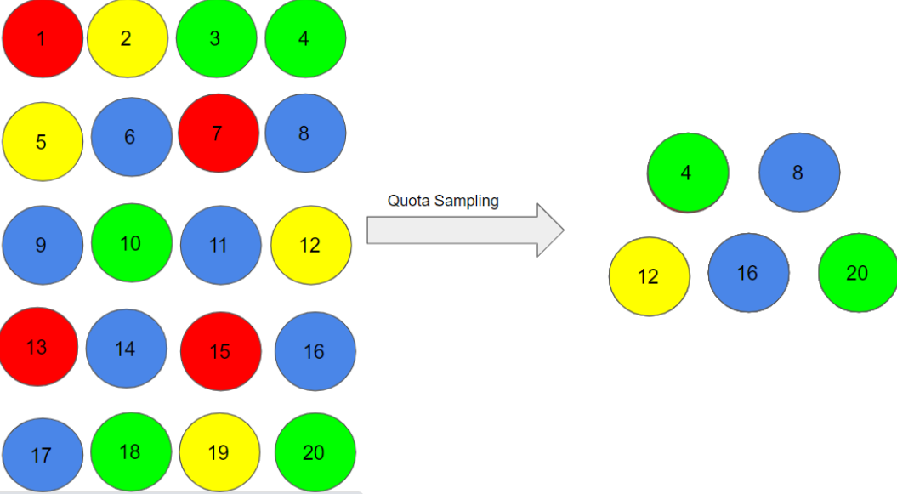
Quota Sampling
In this type of sampling, we choose items based on predetermined characteristics of the population. Consider that we have to select individuals having a number in multiples of four for our sample.

Slide 17
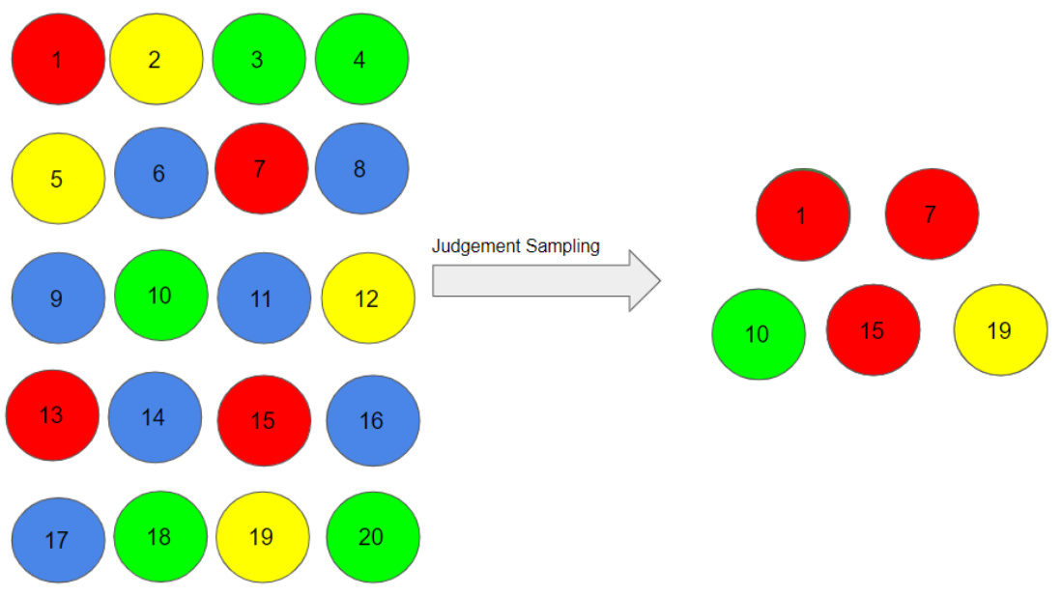
Judgment Sampling
It is also known as selective sampling. It depends on the judgment of the experts when choosing whom to ask to participate.

Slide 18
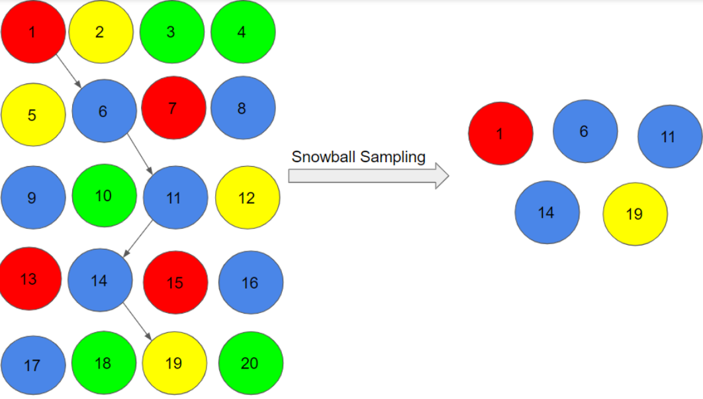
Snowball Sampling
I quite like this sampling technique. Existing people are asked to nominate further people known to them so that the sample increases in size like a rolling snowball. This method of sampling is effective when a sampling frame is difficult to identify.
Here, we had randomly chosen person 1 for our sample, and then he/she recommended person 6, and person 6 recommended person 11, and so on.
1->6->11->14->19

